Slide 1
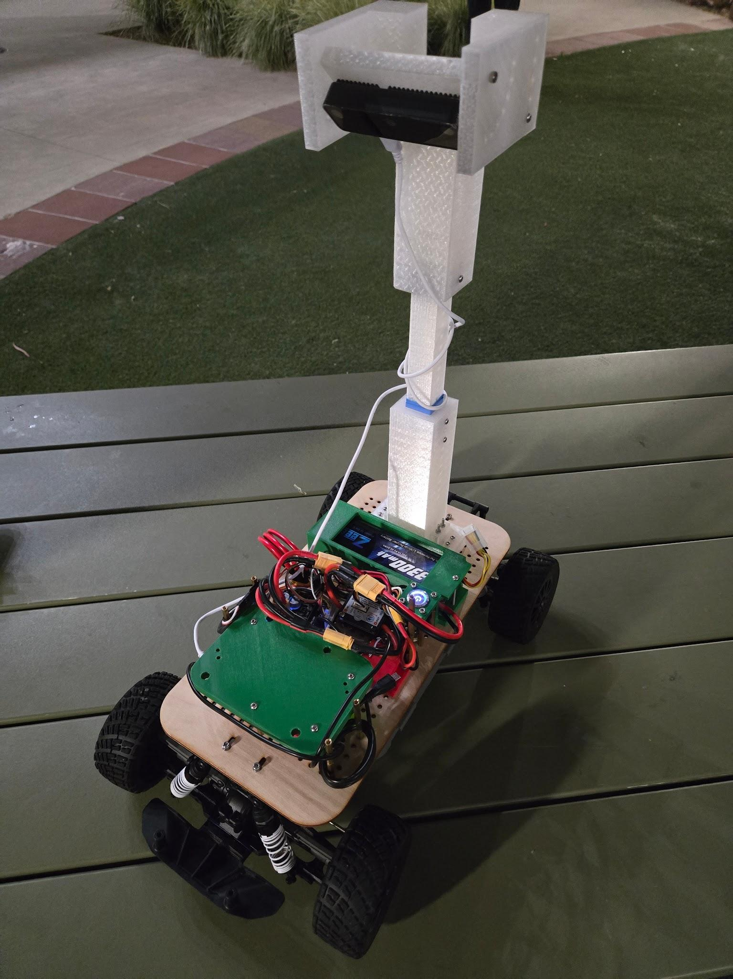

Parking Space Finder
ECE MAE 148 Team 8
Geonmoo Lee – MAE
Christopher Wong – MAE
Henry Tiet – ECE

Slide 2
Reminder of What We Promised
Must Haves:
Camera Recognition of an Open Parking Spot
Vesc Control of Motor to Park into Spot
Avoidance of Blue Tape Lines that Mark the Parking Lot
Nice to Have:
SLAM Mapping of Parking Lot
Identification of Different-sized Obstacles
Understanding Badly-parked Neighbors and Avoidance of Them

Slide 3
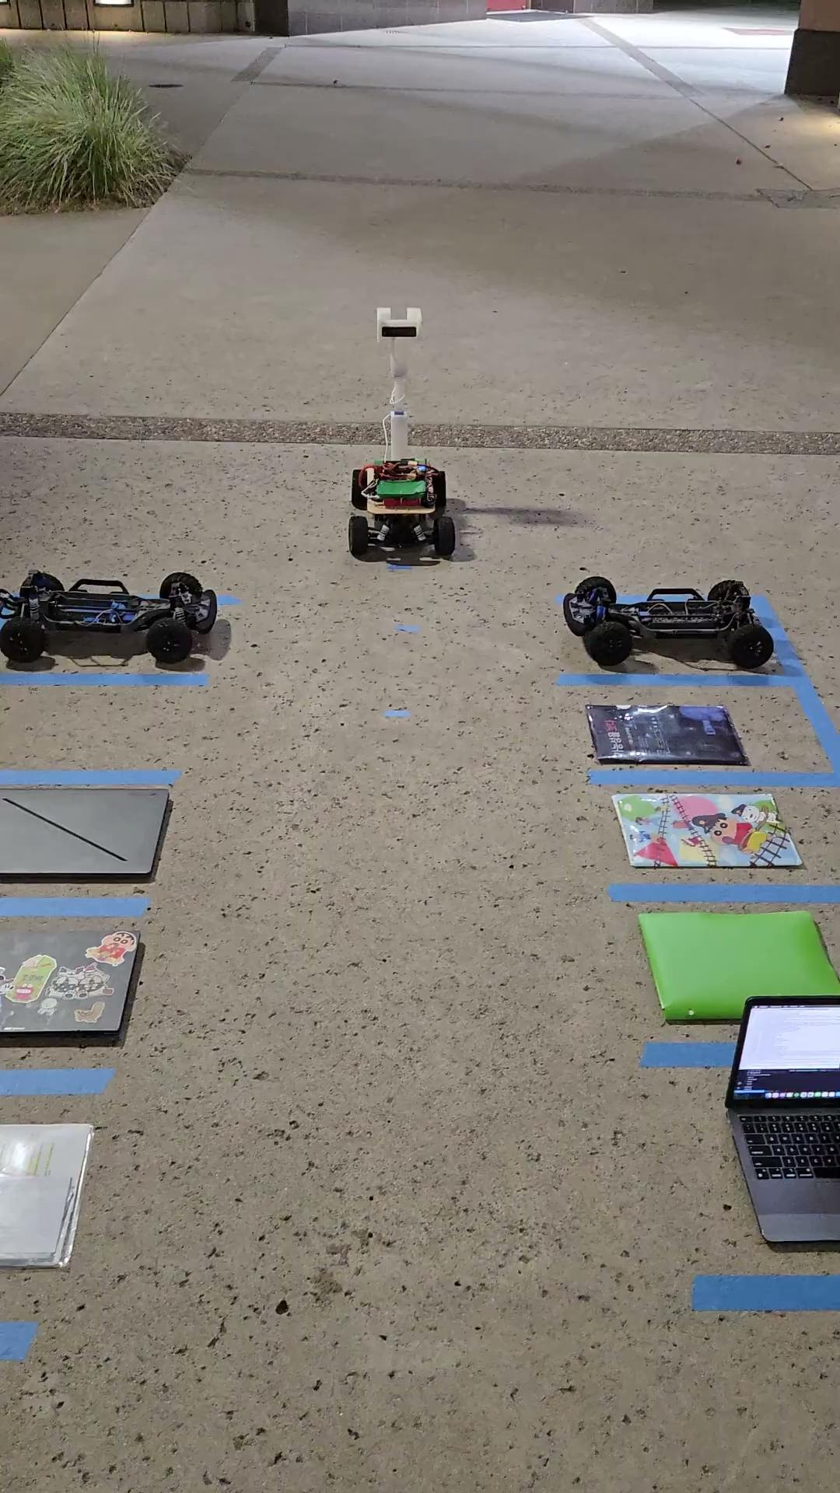

Slide 4
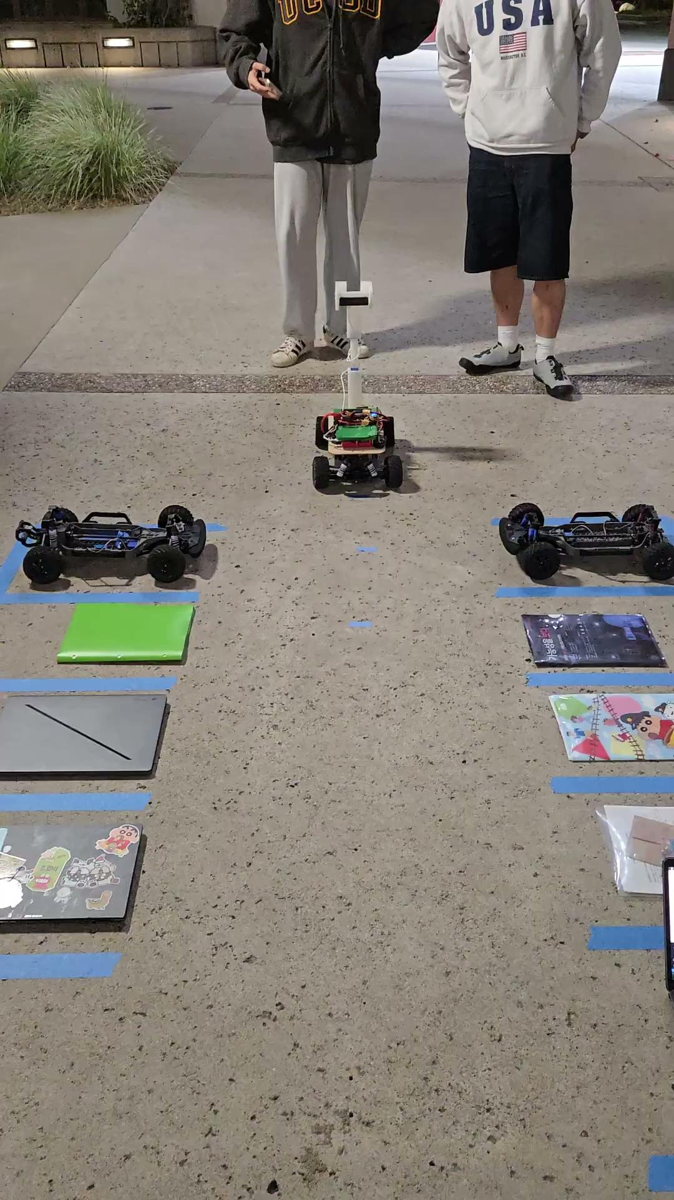

Slide 5
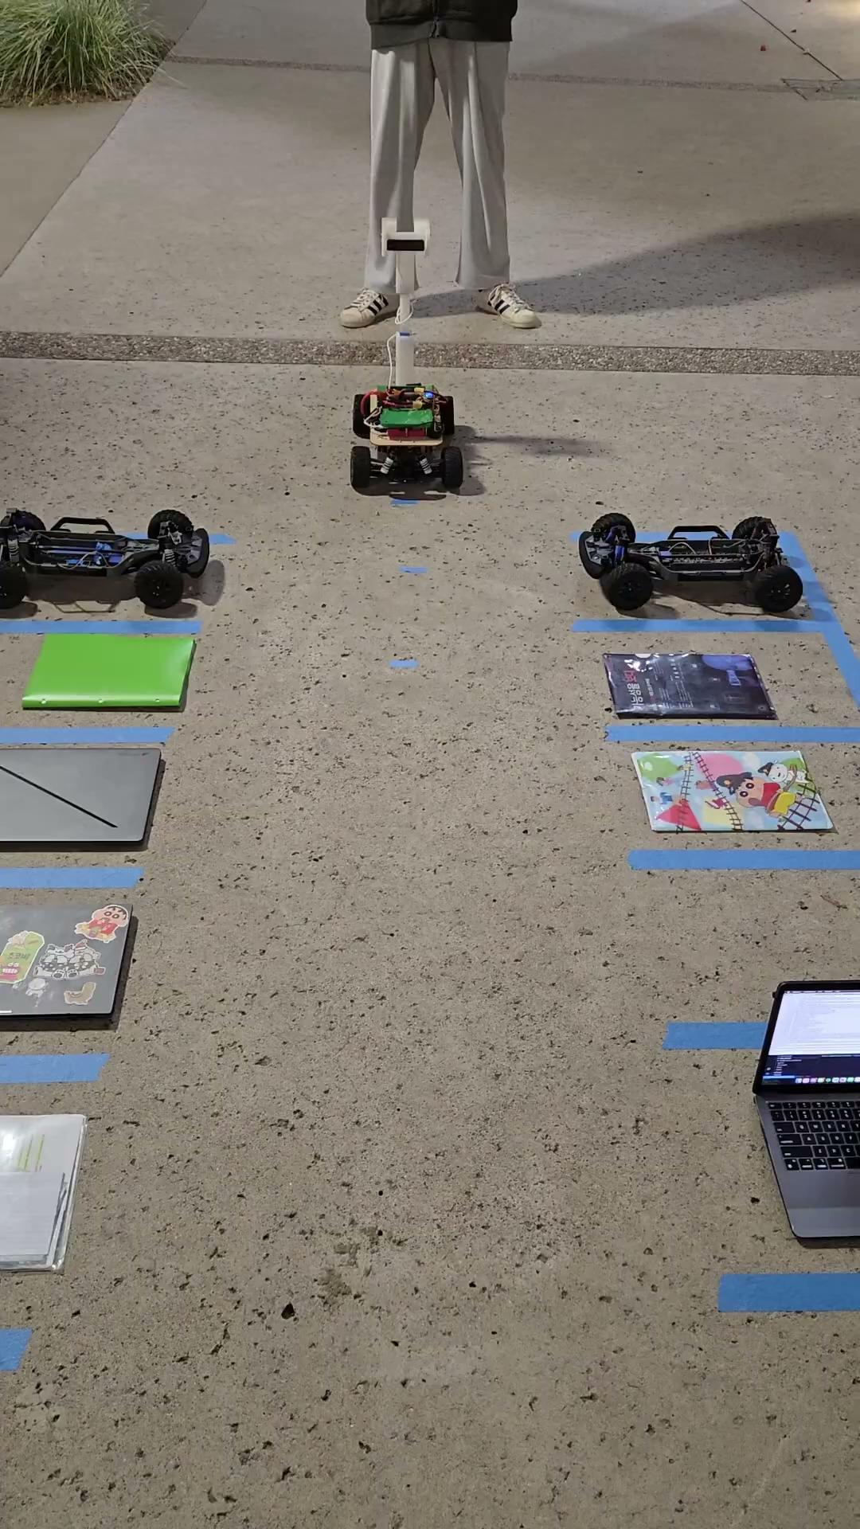

Slide 6
What We Have Done
What Worked:
API call to Roboflow for YOLO model
Camera Output Changes (Masking, Exposure, Hue, ISO)
Communication between VESC and PI for auto parking
What didn’t Work as Expected and Why:
Training an Onboard YOLO model with high enough confidence – Not enough photos in the database (200) OR Roboflow has unique weights to its training model that we didn’t have
Odometry - precise control was still difficult due to misalignment of the wheels
How can we Solve the Issue(s):
Adding more photos with good annotations should have allowed for a better model and higher confidence (annotating the taken spaces may also have helped)
Extra time working with ROS2 and a bit more trial and error should have enabled us to properly engage with the program, we used a predetermined set of timed input pulses as a bandaid solution

Slide 7
If we had another week
Extend our Existing Parking Lot
Add a loop and curve the parking lot for a bigger section
Add path following for more Complicated Parking Lots
With a curvy parking lot, path following will be required to not cross over any parking lines
Train a Working YOLO model for Onboard Processing
Our currently model API calls back to Roboflow due to multiple YOLO models having too low of confidence in identifying parking spots (less than 0.05)
Make Parking More Robust
Use the camera while parking to ensure that the parking is accurate and doesn’t get off track, like ensuring the car is parked fully into the parking spot (from using the blue line in front of it) and that the car doesn’t go over the parking lines

Slide 8
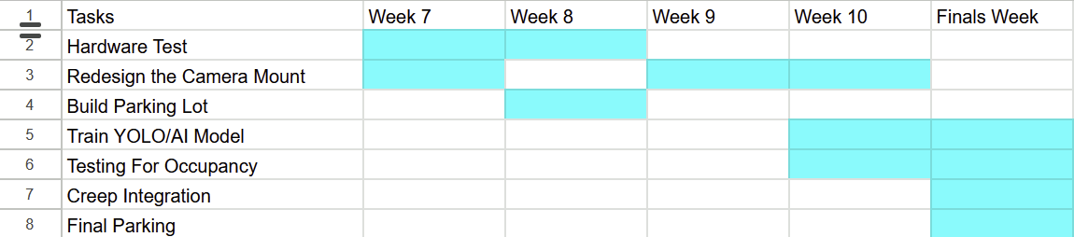
Gantt Chart Update

Slide 9
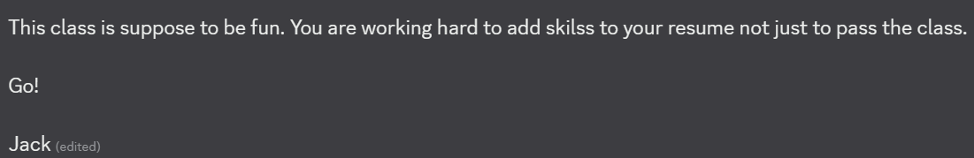
Lessons Learned
For any image-based models, try and have consistent lighting or have multiple photos of differing lightings
The amount of images needed for a YOLO model is much higher than you think
For debugging, program an update output for the program to display for instant feedback
Allot more time for each and every step as you will need at the least 1.5x the amount of time you think you need for project steps
Charge the battery at the end of using it so that next time there isn’t a need to start with charging the battery
Don’t leave the battery plugged in overnight (even the battery monitor), even when the robot is not powered on (We learned the hard way)
remember:

